Slide 1
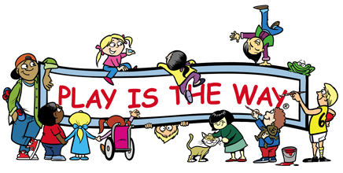
Merritt Central Elementary Play Is The Way Lighthouse School
Enhanced Learning Pan
2017-2020

Slide 2
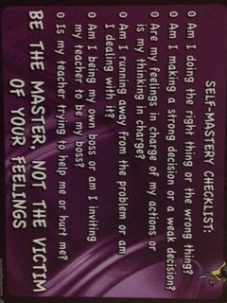
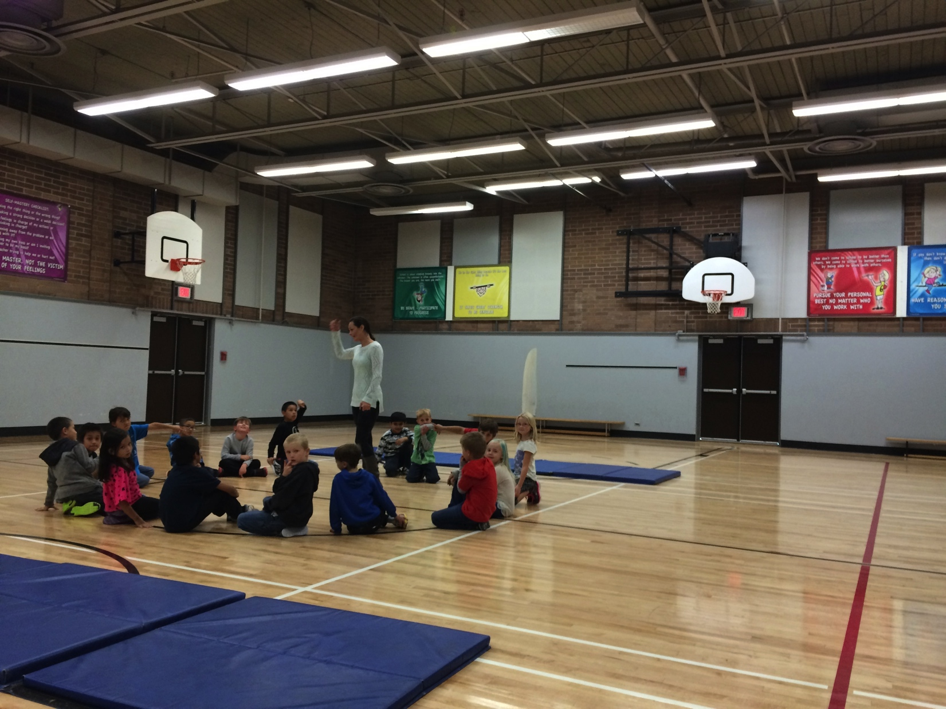
“Emotions are not rigid and inflexible. Even the most powerful can be bent and shaped to serve us better.”
Well Being – To increase the ability of our students to be the master and not the victim of their feelings in both social and academic situations through the Play Is The Way Social Emotional Learning Program.
To assist, students, staff, and parents in creating and maintaining a safe learning environment.
To assist students in becoming independent, self-regulating, self-motivated learners who will pursue their personal best regardless of who they work with.
To foster a culture of empathy amongst our students, staff and parents that is considerate of each other and the world in which they live.
To help students develop an understanding of all our school virtues so they will become people of strong character and decency in our school community and the community in which they live.
Related Action Items
PLAY IS THE WAY ➔ | GAMES ➔ | LIFE RAFT (BEHAVIOUR EDUCATION)➔
GROWING PERSONALLY AND SOCIALLY (GPS) ➔ | REFLECTION, REPAIR AND RESISTUTION (3 R’S) ➔ | ULTIMATE COMMUNITY ROLE MODEL (UCM/Virtues) ➔
CORE COMPETENCIES / PITW CURRICULUM | HEALTHY SCHOOLS (daily breakfast, snacks, hot lunch, fruit and veggie program) | ACTION BC & PACIFIC SPORT

Slide 3
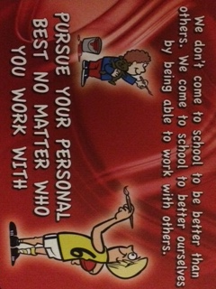
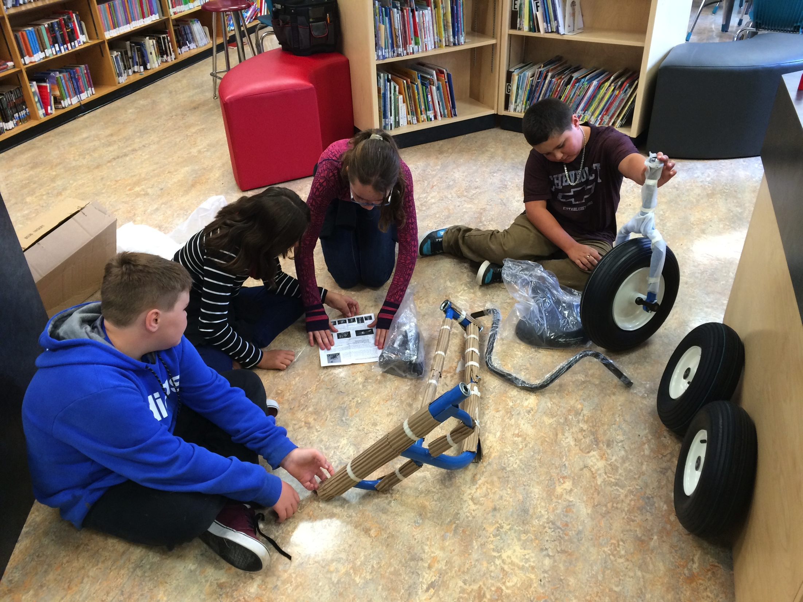
“Learning calls for the revealing of what you do or don’t know. Every act of revelation is an act of courage.”
Learning - Increase the Level of Student and Staff Engagement in Learning.
To close the grade equivalency gap in the areas of literacy and numeracy.
To improve student success through differentiation and Assessment for Learning pedagogical practices.
To improve student learning and engagement by offering opportunities to learn through a variety of programs.
Maker Spaces | English As A Second Dialect | Blended learning
Project Based Learning | Curriculum Support | Response To Intervention (RTI)
Fall & Spring Assessments | School Based team (SBT) | Foundational Skill programs
Literacy/Numeracy Blitzes | ADST/Aboriginal Culture | Collaboration/ Inquiry

Slide 4
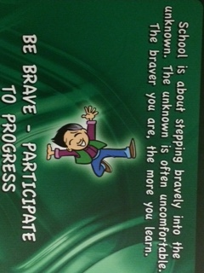
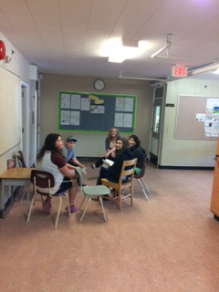
“Be grateful for failure and disappointment. By buckling your knees they give you the chance to flex and jump to even greater heights.”
Learning - Identify and Address Student Learning Needs Effectively
Develop systems to monitor and support student transitions
Develop and monitor student profiles
Review learning assistance support, identify best practices and implement them school wide
Related Action Items
Response to Intervention (RTI) | Enhanced Learning Teacher (ELT) | School Based Team (SBT)
PM Benchmarks / Fountas & Pinnell/Gates Mc Ginitie /Diagnostic Math Assessment | FNSW Student Transitions | Blitzes
Early Primary Team | Late Primary Team | Intermediate Team

Slide 5
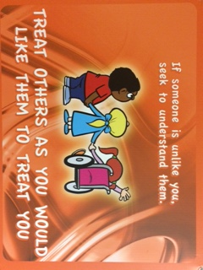
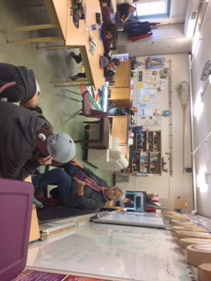
“No one can alter the past. But for better or worse the past can alter the present.”
To increase the mount of Aboriginal Culture in our school community and within our classrooms.
To increase the number of classroom based cultural activities.
To fully implement the new curriculum into our classrooms.
To use Elders and FNSW to integrate Aboriginal culture and crafts into our classrooms as means to teach the new ADST curriculum.
To maintain the number of students partcipating in drumming and other Aboriginal activities during non instructional time.
Related Action Items
Drumming – Spirit Lifters | ADST Activities with Elders | Story Telling | Field Trip (pit house, residential schools, etc)
Ice-Fishing | Elder visits | ESD Support | After School Tutoring
Bit Root Picking | Tea Picking | Primary Language Development | Girls Group/Boys Group

Slide 6
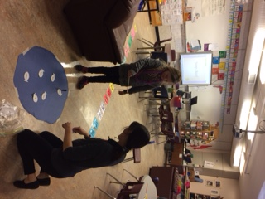
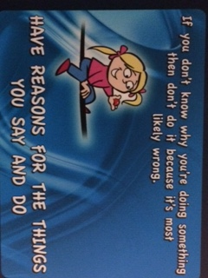
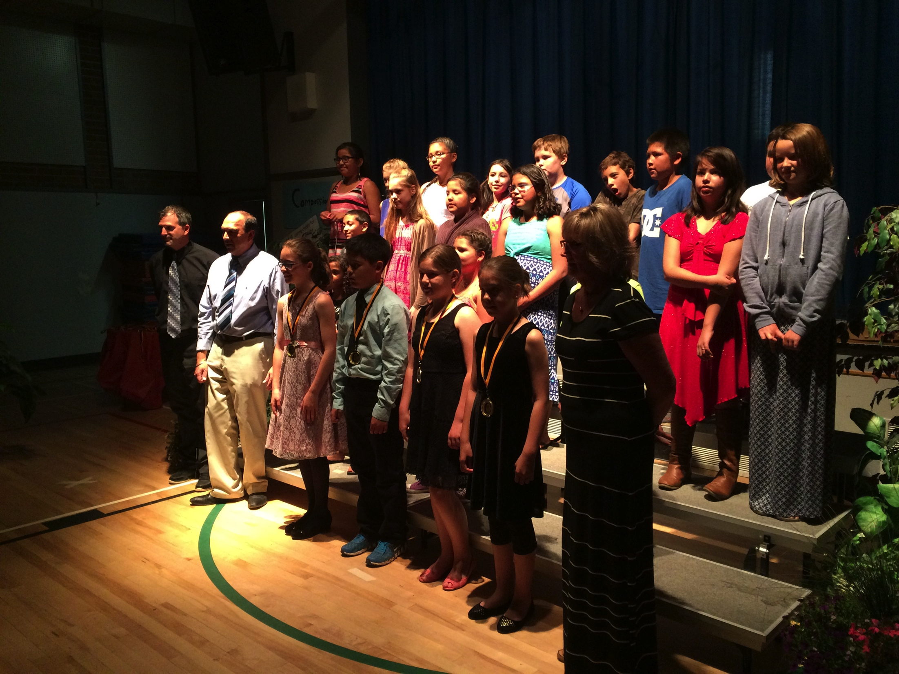
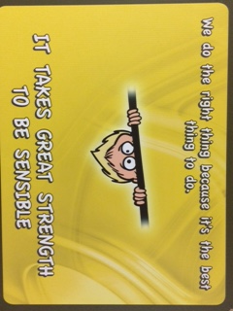
Merritt Central Elementary Play Is The Way Lighthouse School
Enhanced Learning Pan
2017-2020

